Slide 1



DEPARTMENT OF COMPUTER SCIENCE & ENGINEERING
SCHOOL OF COMPUTING
10214CS602 MINOR PROJECT -II
WINTER SEMESTER(2023-2024)
SEMESTER END PROJECT VIVA VOCE EXAMINATIONS
“BRAIN TUMOR BOUNDARY DETECTION FOR PROGNOSTIC ASSESSMENT”
SUPERVISED BY
PRESENTED BY
Dr.S. SRIDEVI,ME.,Ph.D.,
1.DARA SRI KUMUDA VALLI 20578 21UECM0054
2.G.POOJITHA 19484 21UECM0081
3.YAZHINI G 19496 21UECM0265

Slide 2
OVERVIEW
ABSTRACT
OBJECTIVE
INTRODUCTION
LITERATURE REVIEW (SOFT COPY OF PAPERS TO BE LINKED AS HYPERLINK)
DESIGN AND METHODOLOGIES
IMPLEMENTATION
TESTING
INPUT AND OUTPUT
INCLUDE DEMO VIDEO (You Tube URL of complete demonstration of project by All members as Voice over)
CONCLUSION
FUTURE ENHANCEMENTS
SOCIETAL IMPACT OF PROJECT
WEB REFERENCES LINK (TILL REVIEW DATE ALL LINKS TO BE INCLUDED DAY WISE)
PLAGIARISM REPORT OF PROJECT REPORT AND PPT
POSTER PRESENTATION
JOURNAL/CONFERENCE PUBLICATION PROOF
REFERENCES

Slide 3
ABSTRACT
The brain is the most important organ in the human body, responsible for con trolling and regulating all critical life functions for the body and a tumor is a mass of tissue formed by the accumulation of abnormal cells, which keep on growing.
A brain tumor is a tumor which is either formed in the brain or has migrated No primary cause has been identified for the formation of tumors in the brain till date.
Though tumors in the brain are not very common (Worldwide brain tumors make up only 1.8 of total reported tumors), the mortality rate of malignant brain tumors is very high due to the fact that the tumor formation is in the most critical organ of the body.
Hence, it is of utmost importance to accurately detect brain tumors at early stages to lower the mortality rate.
We have thus proposed a computer-assisted radiology system which will assess brain tumors from MRI scans for the management of brain tumor diagnosis.

Slide 5
OBJECTIVES
Aim of the Project:
This project is based on detecting the tumor, from the images using Deep Learn ing (CNN) and implementation in application.
The application is developed for the purpose to provide the users with an easy way to interact with the app to detect the disease in early stage .
This app basically helps us to prevent the disease in the early stage by detecting the disease.
This application basically helps us to upload the image of the affected disease that he/she wishes to diagnose
Scope of the Project:
The main objectives of this application is to help the users to identify the diseases at the early stage, make a user friendly platform to detected disease, to ease the task for us to identify the disease with the help of technology which is better than naked eye.
The android is developed to provide the users with an easy way to interact with the app to detect what is going on in their health.
Main aim is to develop an automated system for enhancement, segmentation and classification of brain tumors.

Slide 6
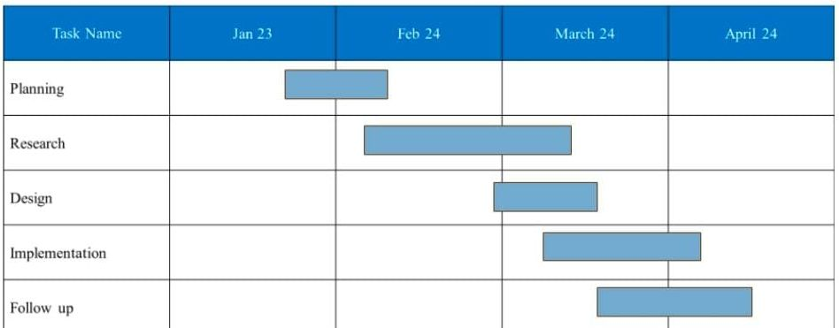
TIMELINE OF THE PROJECT

Slide 7
INTRODUCTION
The human body consists of myriad number of cells. When cell growth becomes uncontrollable the extra mass of cell transforms into tumor.
CT scans and MRI scans are used for identification of the tumor. The goal of our study is to accurately detect tumors in the brain and classify it through the means of several techniques involving medical image processing, pattern analysis, and computer vision for enhancement, segmentation and classification of brain diagnosis.
This system can be used by neurosurgeons, radiologists and healthcare specialists. The system is expected to improve the sensitivity, specificity, and diagnostic efficiency of brain tumor screen ing using industry standard simulation software tool, MATLAB.
These techniques involve pre-processing of MRI scans collected from online cancer imaging archives as well as scans obtained from several pathology labs.
Images are resized and then we apply the proposed algorithms for segmentation and classification.
The system is expected to improve the brain tumor screening procedure currently at use, and possibly reduce health care costs by decreasing the need for followup procedures.

Slide 8
LITERATURE REVIEW
Sl.No | Author’s Name | Paper name and publication details | Year of publication | Main content of the paper
1 | Afshar | Single-trial neural correlates of arm movement preparation | 2021 | Polyps in the colon or rectumThese groDetection of Diseases Using Machine Learning Image Recognition Technology in Artificial Intelligencewths are called polyps.
2 | Alizadeh | Detection of Diseases Using Machine Learning Image Recognition Technology in Artificial Intelligence | 2020 | With the continuous development and improvement of artificial intelligence technology
3 | Amor | Mobile health applications for disease screening and treatment support in low-and middle-income countries. | 2022 | The advances in mobile technologies and applications
4 | Bahado- Singh | Artificial intelligence in disease diagnosis | 2021 | Artificial intelligence can assist providers in a variety of patient care and intelligent health systems
Sl.No | Author’s Name | Paper name and publication details | Year of publication | Main content of the paper
1
2
3
4
Select the IEEE papers that were published between 2019 and 2023.
8 IEEE papers should be referred.

Slide 9
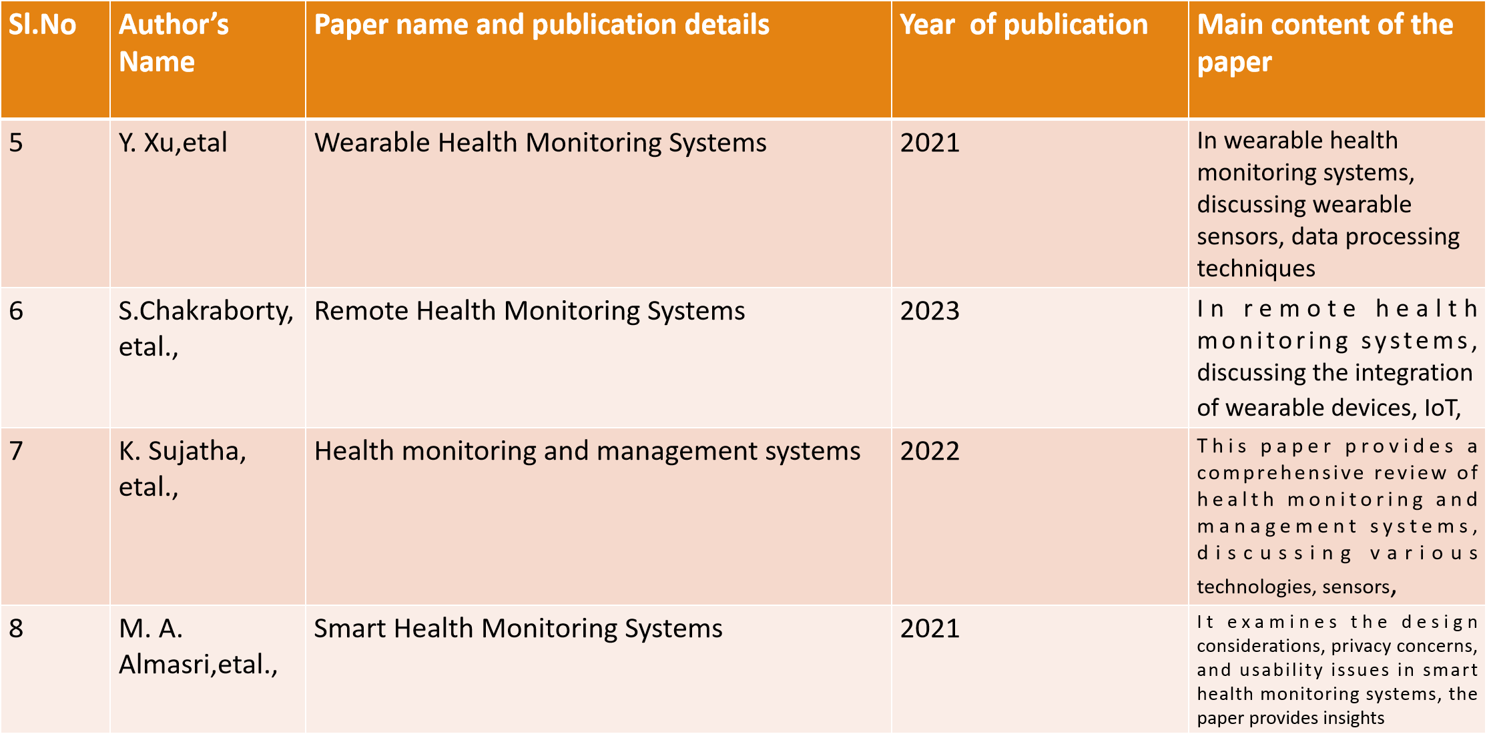
5
6
7
8

Slide 10
DESIGN AND METHODOLOGIES
MODULE 1: Collection of Data
MODULE 2: Algorithm
Convolutional Neural Network(CNN)

Slide 11
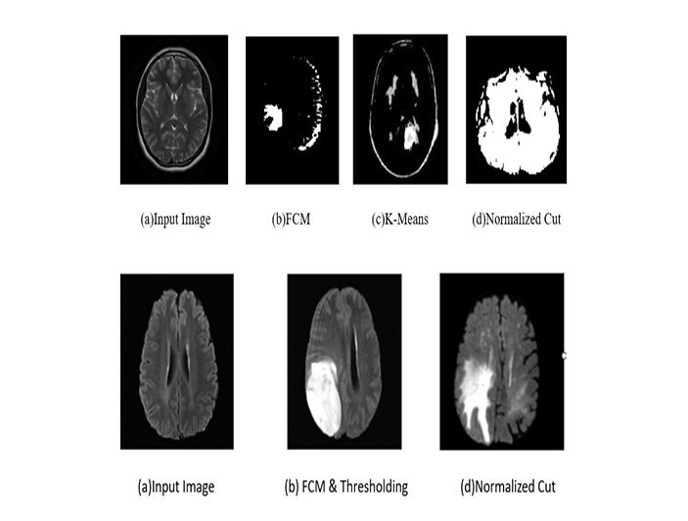
MODULE 1
Step:1 Collection of data
The dataset used in our project includes different diseased classes.

Slide 12
Module 2 : Convolutional Neural Networks
Convolutional Neural Networks are a complex neural network chain which work to get the features of an image from a dataset which is trained and classify them to get the required output.
It trains the neural networks by using the dataset images and changing them to numerical values.
The main advantage of CNN compared to its predecessors is that it automatically detects the important features without any human supervision....ConvNets are more powerful than machine learning algorithms and are also computationally efficient.
These numerical values are then put into numerical arrays based on their categorized characteristics. These arrays are then put into different nodes in the network and passed through multiple iterations based on the input given.
The CNN models are used for geographical classification in multiple companies which require data to be classified in a quick and secure way it almost acts like a filter removing dust and separates the features of the images.

Slide 13
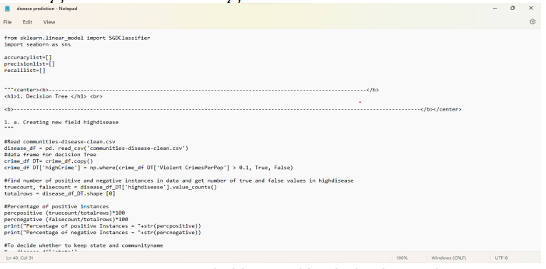
Step 3: Using algorithm’s name algorithm
Include screenshot of the algorithm
Eg,
It’s a sample only and may vary according to the project

Slide 14
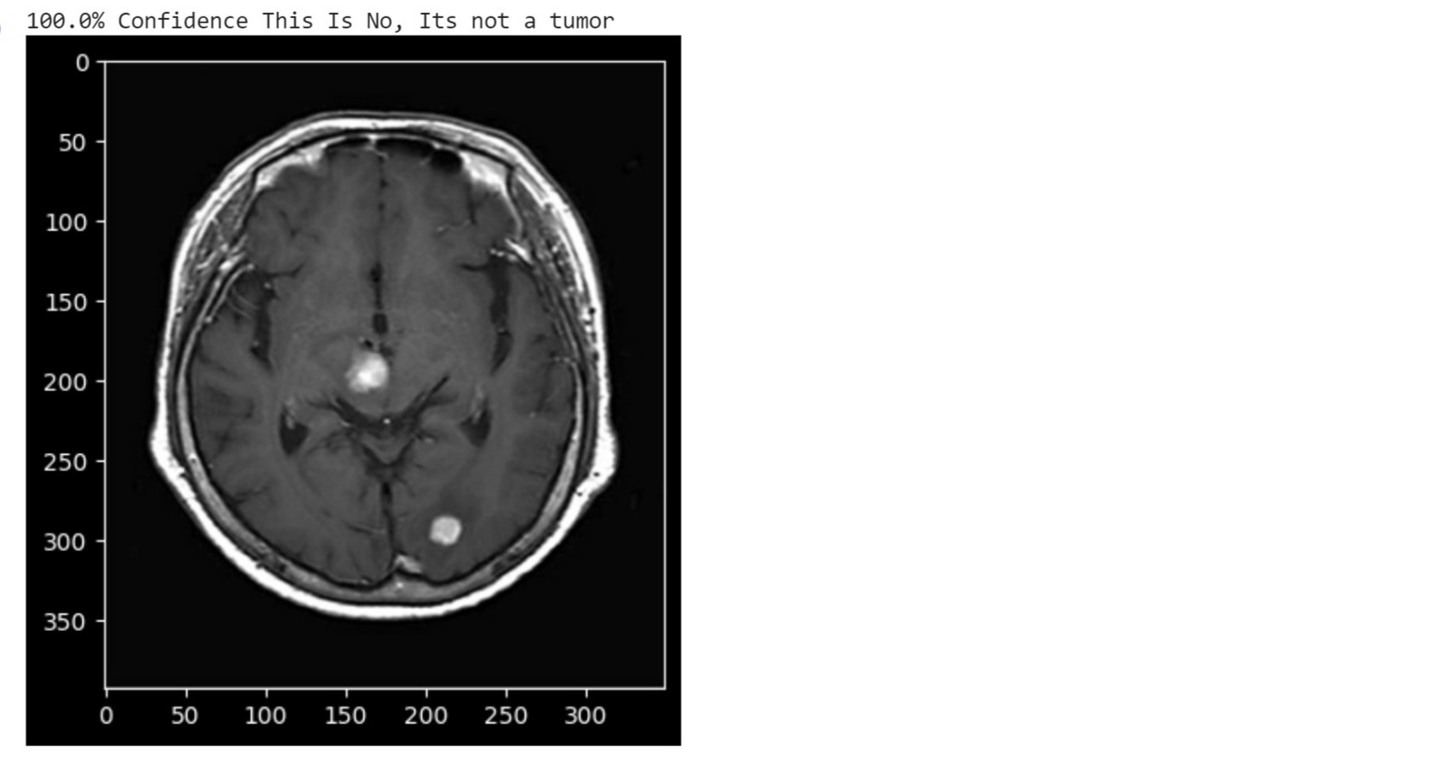
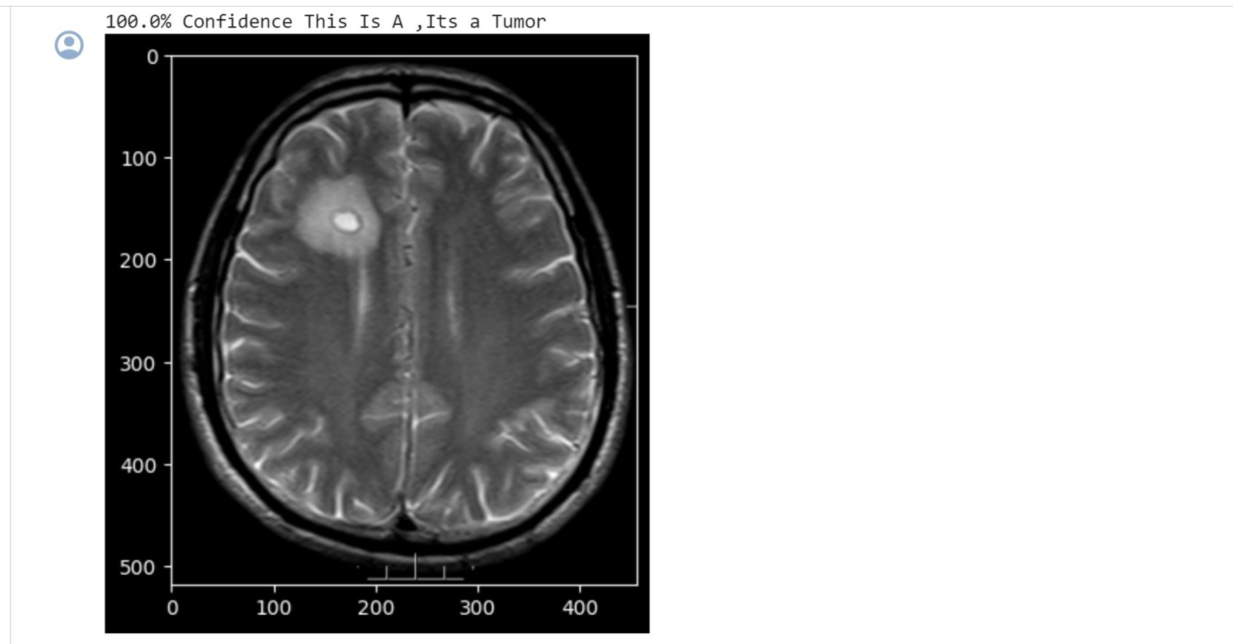
Step 4: The output

Slide 15
IMPLEMENTATION
Architecture Diagram
Data –Flow Diagram
Use Case Diagram
Class Diagram
Activity Diagram
Sequence Diagram
Collaboration Diagram
E-R Diagram

Slide 16
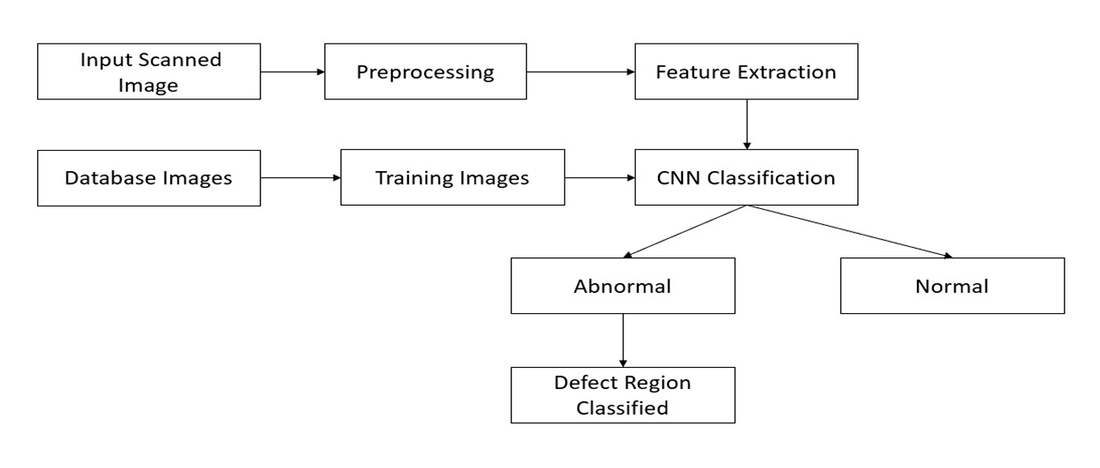
Architecture Diagram
Architecture Diagram, the input is given in form of image and the image is sent to preprocess data for feature extraction .
Those extracted details are sent to Convolutional Neural Network (CNN), where with used of algo rithm there are database image and trained images.
In Convolutional Neural Net work (CNN) , we can classify into two Normal and Abnormal.If it is Abnormal then it shows the predition of tumour is provided and defect region is classified

Slide 17
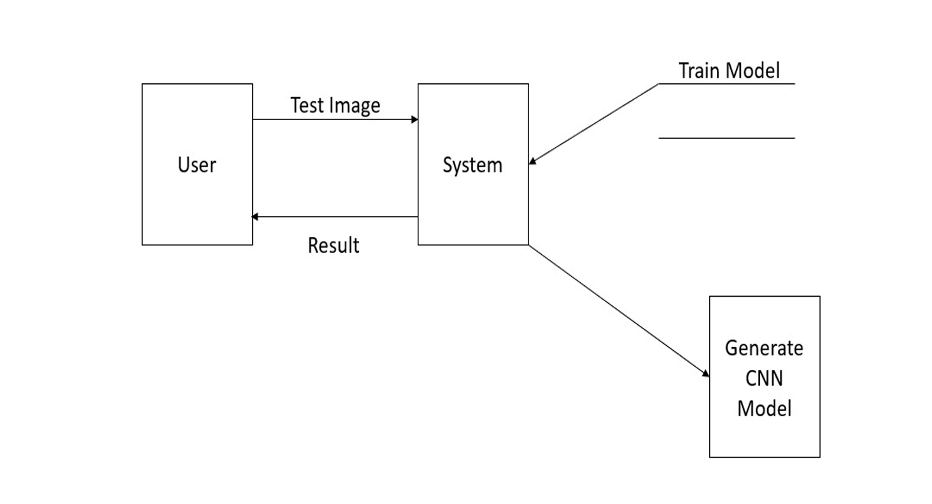
Data –Flow Diagram
Dataflow Diagram ,as we see the user can send and recieve the information .
The input is given to the system and output is generated in form of instructions.
The System is a trained model to generate a appropriate result.

Slide 18
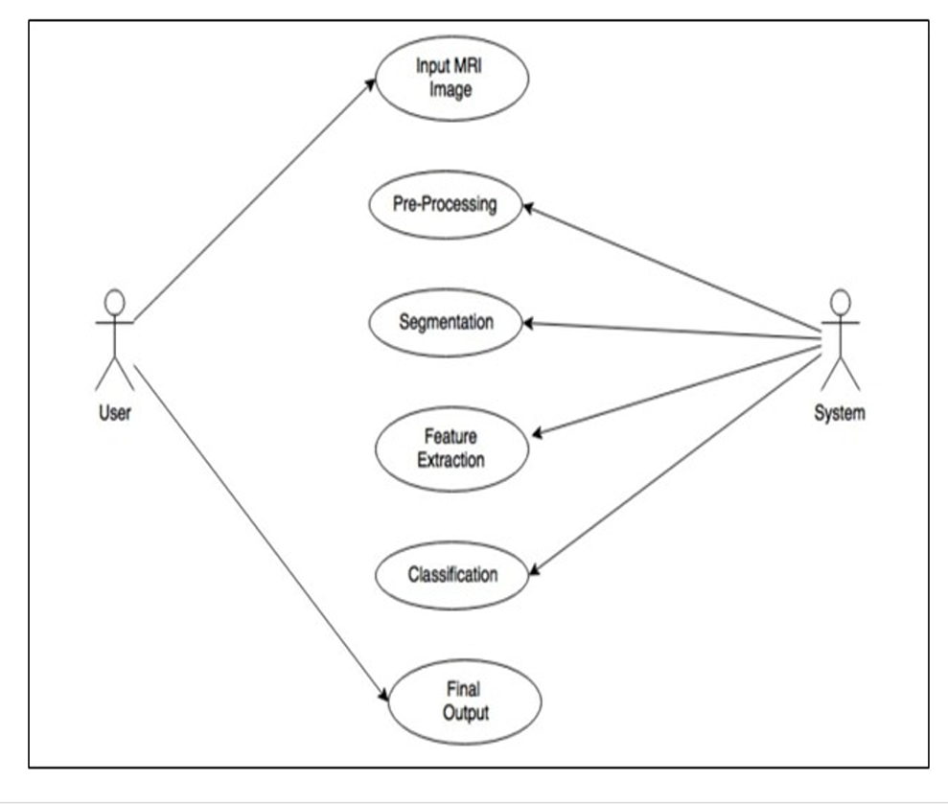
Use Case Diagram
Use Case diagram for tumor detection using machine learning, you would typically identify the various actors or entities interacting with the system and the specific actions or use cases they perform.
The primary actor responsible for interpreting medical imaging scans and providing diagnoses.
They interact with the system to access and analyze images processed by the machine learning algorithm.
The core component of the system responsible for tumor detec tion using machine learning algorithms. It processes medical imaging data and iden tifies potential tumors or abnormalities.

Slide 19
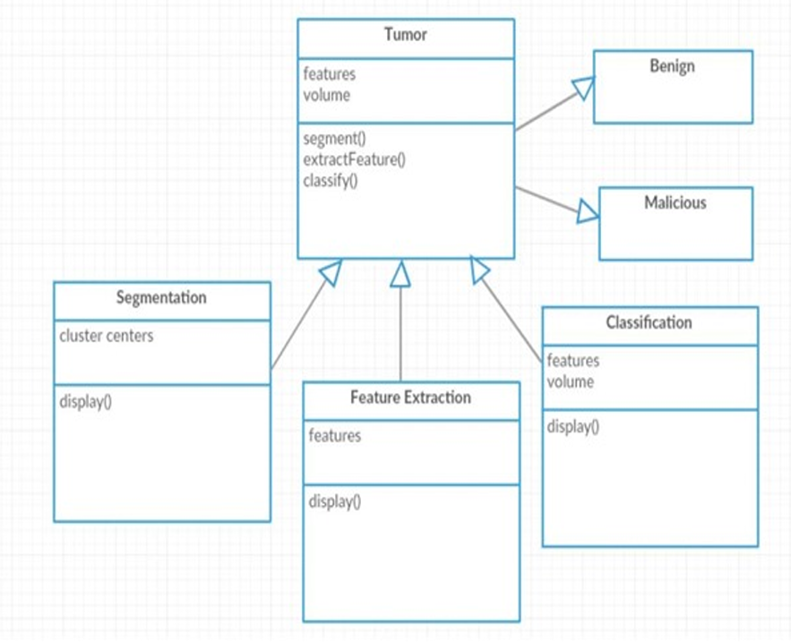
Class Diagram
Class diagram for tumor detection using machine learning would represent the various classes (or entities) in the system, along with their attributes and relationships.
This class diagram outlines the key entities involved in the tumor detection process using machine learning, including patients, medical images, tumor detection algorithms, detection results, healthcare providers, diagnoses, and treatment plans.
It also illustrates the associations between these entities, high lighting how they are related to each other within the system.

Slide 20
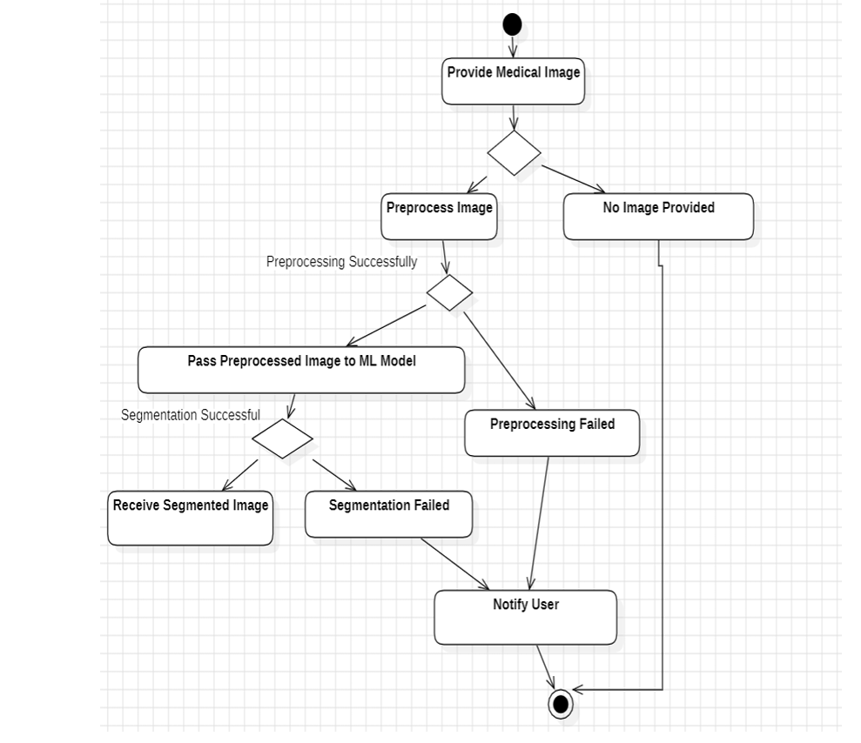
Activity Diagram
Activity Diagram for tumor detection using machine learning can provide a visual representation of the workflow involved in the detection process.
The process begins when a patient uploads a medical image for tumor de tection. The system receives the uploaded image and proceeds to the preprocessing stage.The uploaded medical image undergoes preprocessing to enhance its quality and prepare it for tumor detection.
Preprocessing steps may include noise reduction, normalization, and other image .After preprocessing, the system applies the tumor detection algorithm to the preprocessed image.

Slide 21
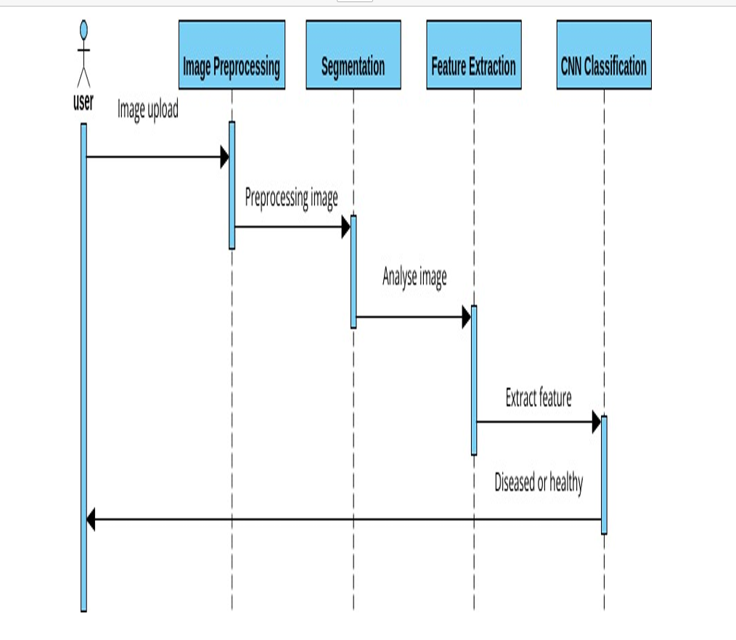
Sequence Diagram
Sequence diagram for tumor detection using machine learning illustrates the interactions between different components or actors in the system over time.
The sequence starts when a patient uploads a medical image for tumor detection.The Patient actor initiates the interaction by sending a request to the system to upload the medical image.
The System acknowledges the request and receives the medical image data.Once the image is uploaded, the System prepro cesses the medical image to enhance its quality for analysis.

Slide 22
E-R Diagram

Slide 23
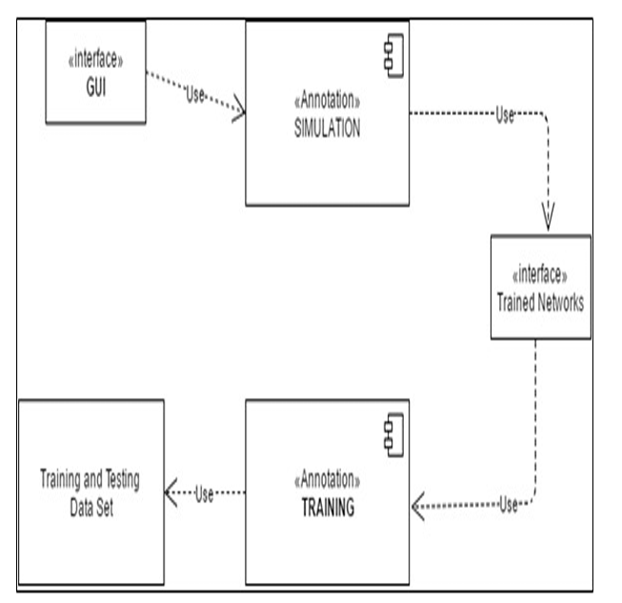
Collaboration Diagram
Collaboration Diagram, also known as a communication diagram, illustrates the interactions and relationships between objects or ac tors in a system.
In the context of tumor detection using machine learning, a col laboration diagram can depict how various components collaborate to achieve tumor detection.
Initiates the process by uploading a medical image for tumor detec tion.Represents the overall system responsible for coordinating the tumor detection process.An object representing the uploaded medical image.

Slide 24
TESTING
UNIT TESTING
INTEGRATION TESTING
FUNCTIONAL TESTING
WHITE BOX TESTING
BLACK BOX TESTING

Slide 25
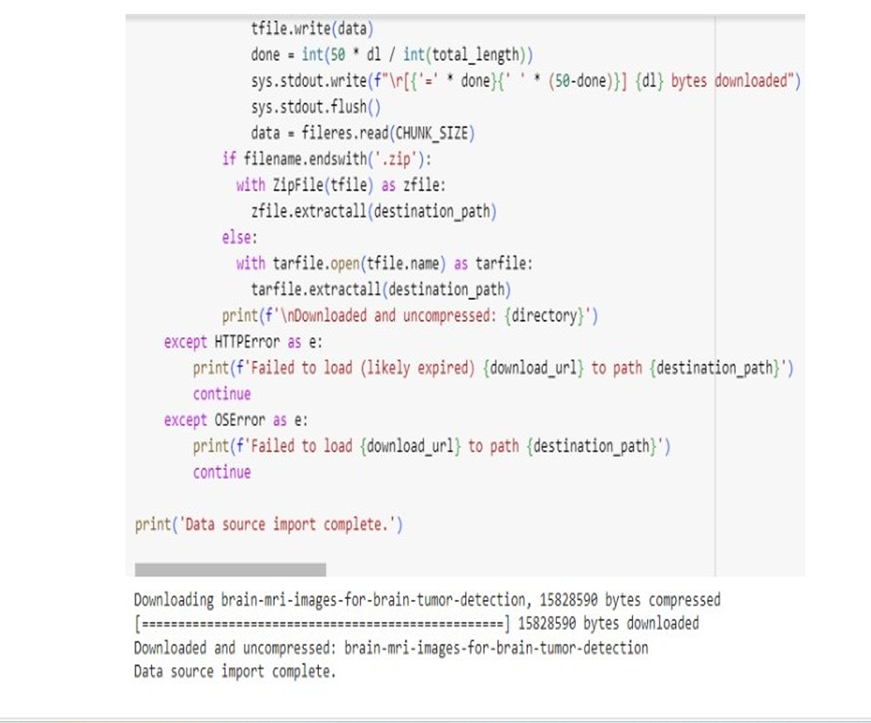
UNIT TESTING
Unit testing is one of the most fundamental software testing process in which the smallest individual units of the software which are testable are scrutinized and ordered for proper execution of the software to give the desired output.

Slide 26
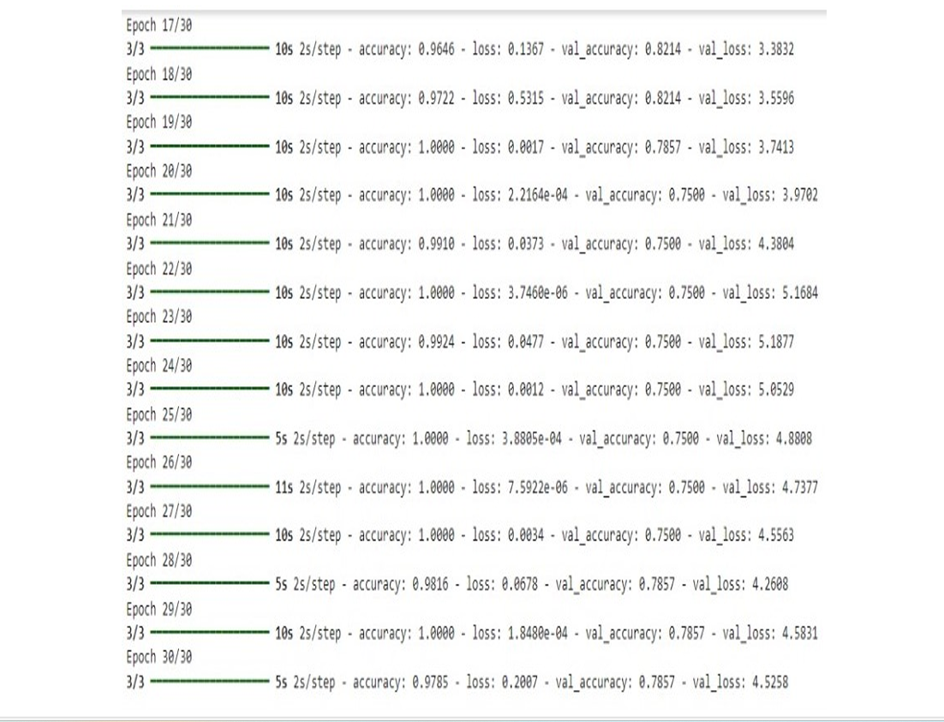
INTEGRATION TESTING
Integration testing is known as the second level of the software testing process, following unit testing. Integration testing involves checking individual components or units of a software project to expose defects and problems to verify that they work together as designed

Slide 27
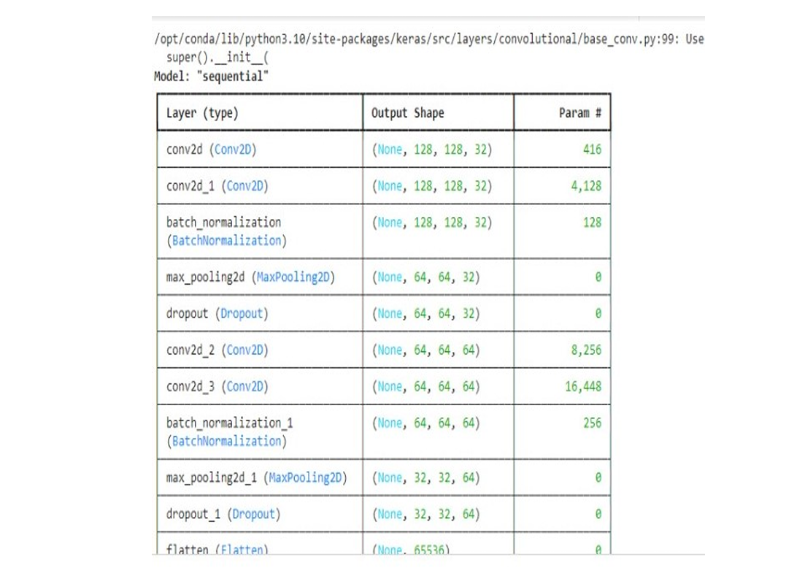
SYSTEM TESTING
System testing is all about the testing of a complete and fully integrated software.

Slide 28
INPUT AND OUTPUT
DATASET IMAGE:

Slide 29
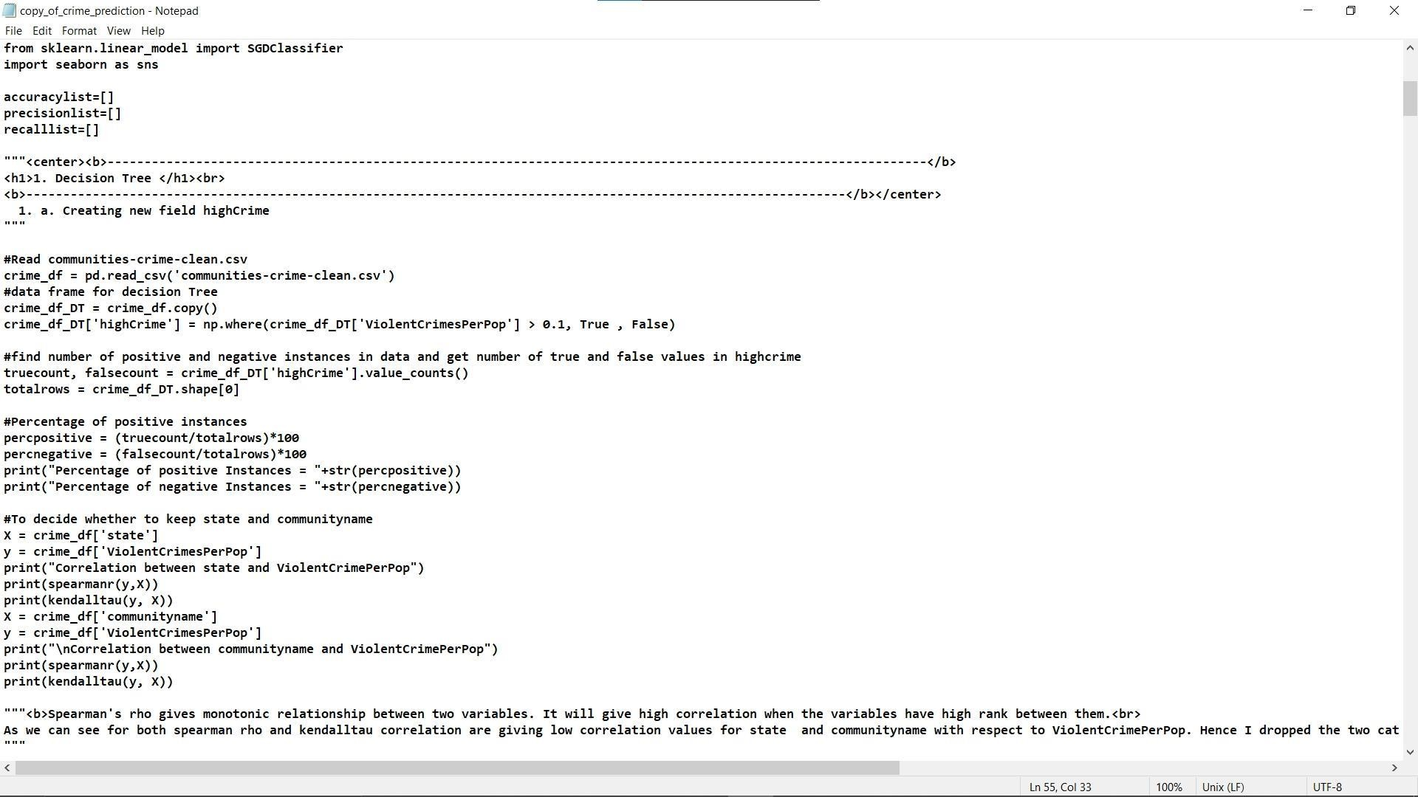
SOURCE CODE
Eg,
It’s a sample only and may vary according to the project

Slide 30
OUTPUT

Slide 31
CONCLUSION
Abnormal growth of tissue in the brain which affect the normal functioning of the brain is considered a brain tumor.The main goal of medical image processing is to identify accurate and meaningful information using algorithms with minimum error possible.
Brain tumor detection and classification through MRI images can be categorized into four different sections: pre-processing, image segmentation, feature extraction and image classification.
Various segmentation methodologies are explored in the project. It can be concluded that the algorithms and the parameters used in the proposed system are all meant to increase the efficiency of the system by achieving better results.
Thus, the proposed methodology which helps in increasing the accuracy of 93% and obtaining the Brain Tumor Prediction.
Encouraged by these results, future work will involve the improvement of clas sification result and overall accuracy. The number of output classes can also be increased if more data is available.
With a more extensive and diverse dataset, the overall classification accuracy can be dramatically increased. Another approach to improve the result would be to increase the number of hidden layers of the neural network.

Slide 32
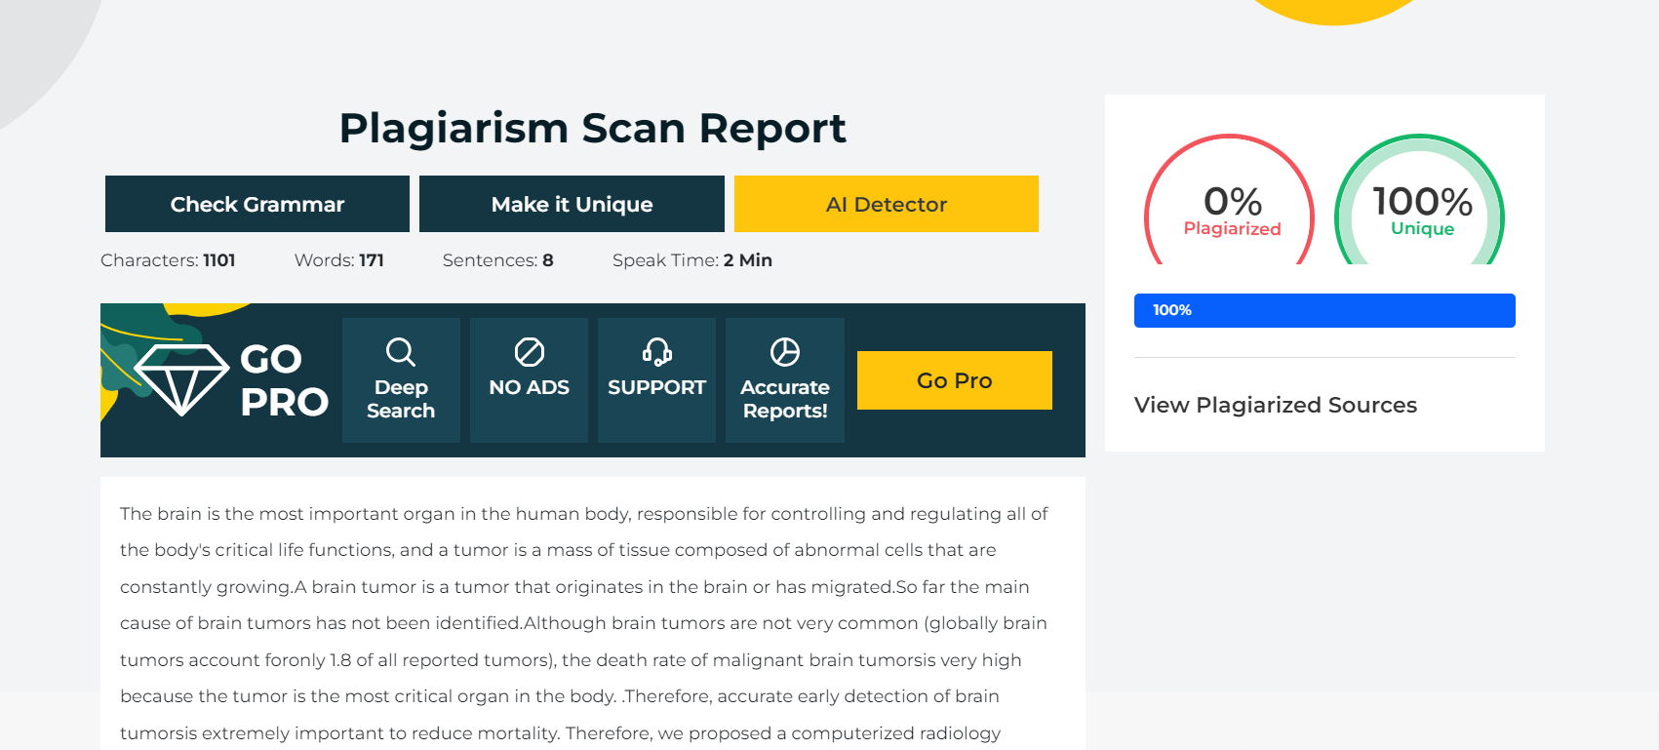
Plagiarism Report of PPT

Slide 33
Web references/video links
https://www.youtube.com/watch?v=JmOfTudgOWY
https://www.youtube.com/watch?v=pp61TbhJOTg

Slide 34
REFERENCES
[1] A. Ladgham, G. Torkhani, A. Sakly, and A. Mtibaa.(2019).Modified support vector machines for MR brain images recognition, International Conference on Control, Decision and Information Technologies (CoDIT).
[2]P. Su, Z. Xue, L. Chi, J. Yang, and S. T. Wong.(2020). Support vector machine (SVM) active learning for automated Glioblastoma segmentation, 9th IEEE International Symposium on Biomedical Imaging (ISBI).
[3] Y. Liu and Q. Zhao.(2020). An improved watershed algorithm based on multi- scale gradient and distance transformation, 3rd International Congress on Image and Signal Processing.
[4] MM. Al-Ayyoub, G. Husari, O. Darwish, and A. Alabed-Alaziz.(2020). Machine learning approach for brain tumor detection,” Proceedings of the 3rd International Conference on Information and Communication Systems- ICICS 12
[5]E. K¨ uc¸¨ ukk¨ ulahli, P. Erdo˘ gmus ¸, and K. Polat.(2020).Brain MRI Segmentation based on Different Clustering Algorithms,International Journal of Computer Applications, vol. 155, no. 3, pp. 37–40, 2016.Mohsen, Fahd, et al. ”A new image segmentation method based on particle swarm optimization.” Int. Arab J. Inf. Technol. 9.5.

Slide 35
[6] Mohsen, Fahd, et al.(2020).A new image segmentation method based on particle swarm optimization. Int. Arab J. Inf. Technol. 9.5 487- 493.
[7] R. V. Rao, Jaya.(2021). A simple and new optimization algorithm for solving constrained and unconstrained optimization problems, International Journal of Industrial Engineering Computations, pp. 18–3.
[8] J. Han, M. Kamber, and J. Pei.(2021). Data mining: concepts and techniques.
[9] I. Maiti and M. Chakraborty .(2021).A new method for brain tumor segmen tation based on watershed and edge detection algorithms in HSV colour model, National Conference On Computing And Communication Systems.
[10] Y. K. Dubey and M. M. Mushrif.(2021).Segmentation of brain MR images using intuitionistic fuzzy clustering algorithm, Proceedings of the Eighth Indian Conference on Computer Vision, Graphics and Image Processing- ICVGIP 12.
[11] K. Hu, G.-Y. Tang, D.-P. Xiong, and Q. Qiu.(2021). A novel image seg mentation algorithm based on Hidden Markov Random Field model and Finite Mixture Model parameter estimation, International Conference on Wavelet Analysis and Pattern Recognition.

Slide 36
THANK YOU

